Slide 1

Red Wine
Report and Analysis
Yafei Lou
Qingqing Hu

Slide 2
Part 1 Overview dataset

Slide 3
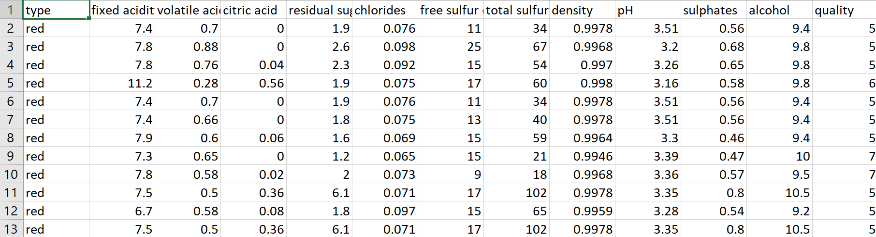
The dataset consists of 1593 rows and 12 Input variables and 1 output variable.
Input variables:
fixed acidity, volatile acidity, citric acid, residual sugar, chlorides, free sulfur dioxide, total sulfur dioxide, density, pH, sulphates, alcohol.
Output variable is the wine quality (score 3~8). Two classes：Good (7~8), Bad(3~6)

Slide 4
Part 2 Models and Analysis

Slide 5
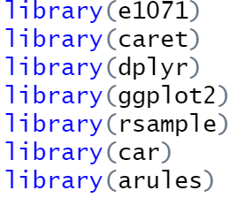
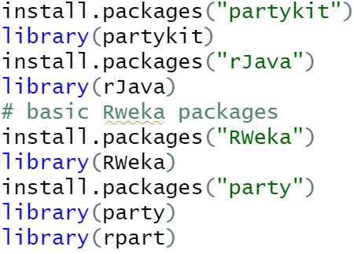
Install packages needed:

Slide 6
Models used:
Association rule
Naive bayes
Logistic regression
Decision tree

Slide 7
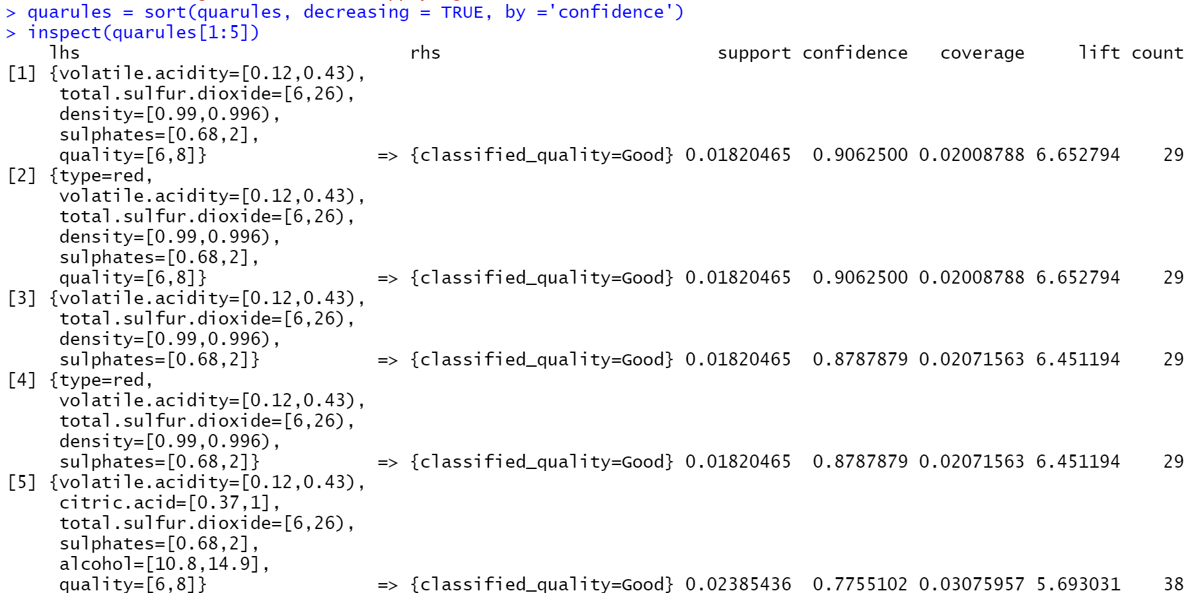
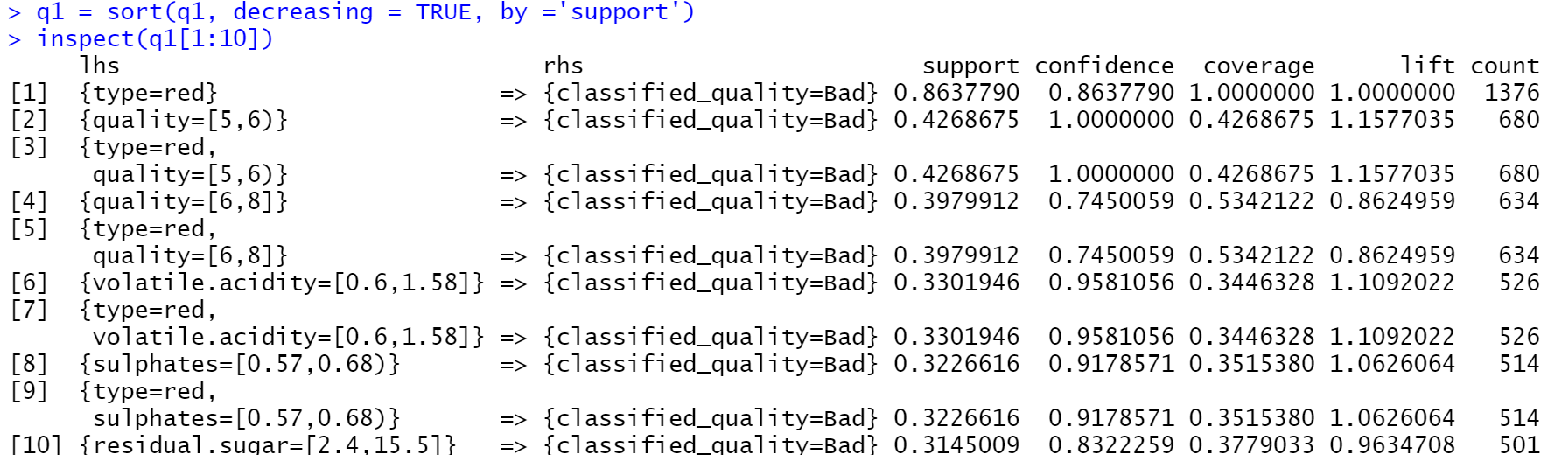
Association rule
Good quality---top 5 rules
volatile.acidity[0.12,0.43)
total.sulfur.dioxide=[6,26)
density=[0.99,0.996)
sulphates=[0.68,2]
alcohol=[10.8,14.9]
Bad quality---top 10 rules
volatile.acidity=[0.6,1.58]
sulphates=[0.57,0.68)
residual.sugar=[2.4,15.5]

Slide 8
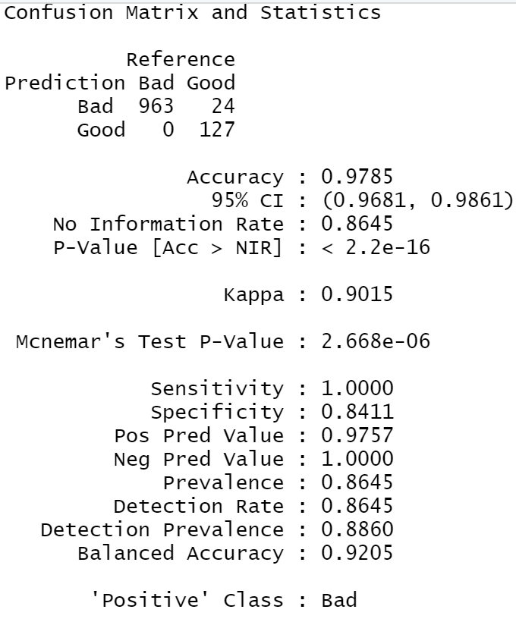
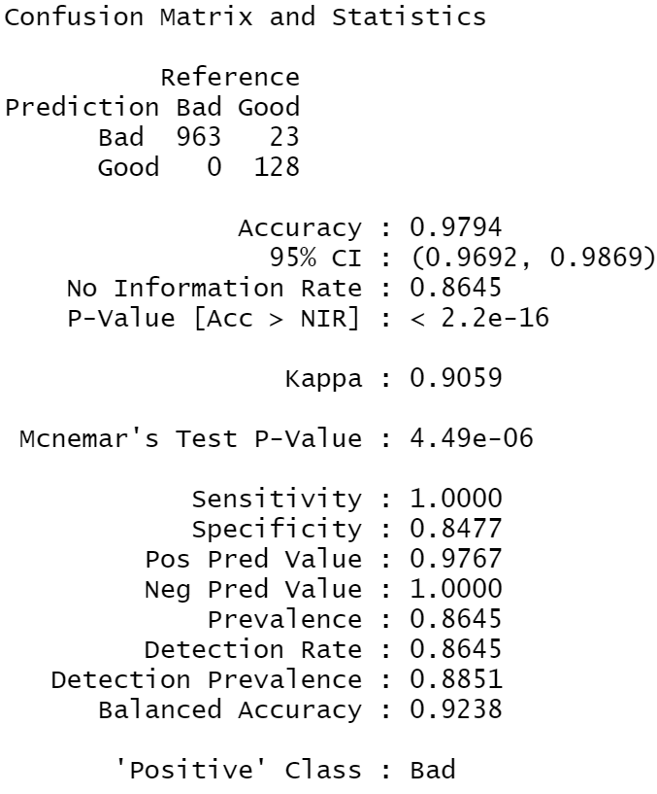
Naive bayes
Split data (30%-train;70%-test)
Comparison of accuracy of models (standardize or not)
Before:97.85%
After:97.94%
VS

Slide 9
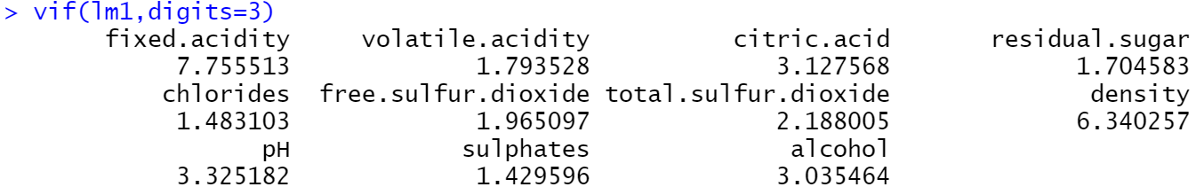
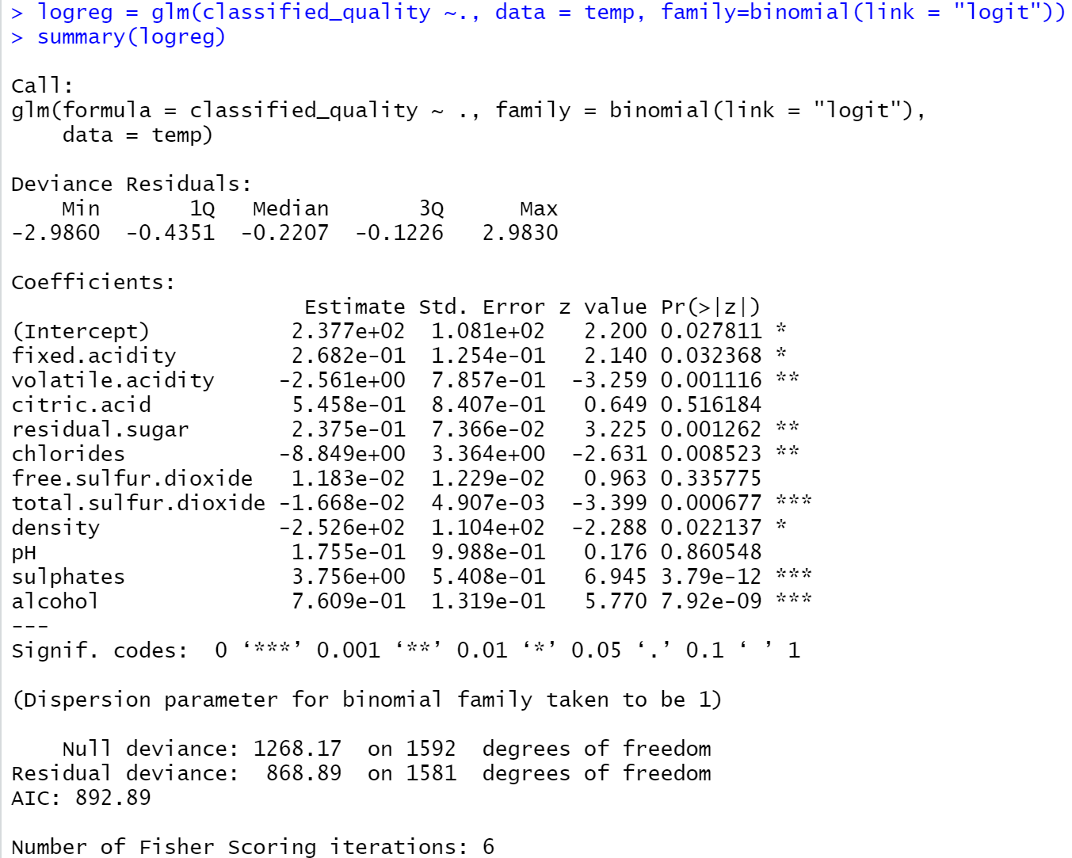
Logistic regression
vif<10-- no linearity between 11 variables
Most significant:
total.sulfur.dioxide
sulphates
alcohol
No significance:
citric.acid
free.sulfur.dioxide
pH

Slide 10
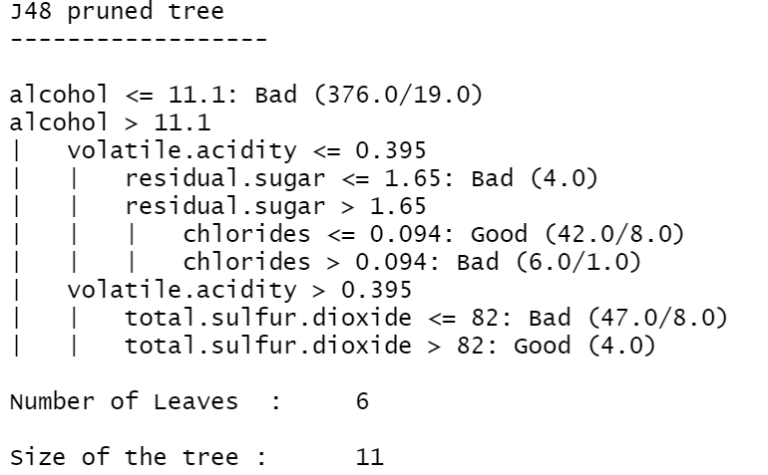
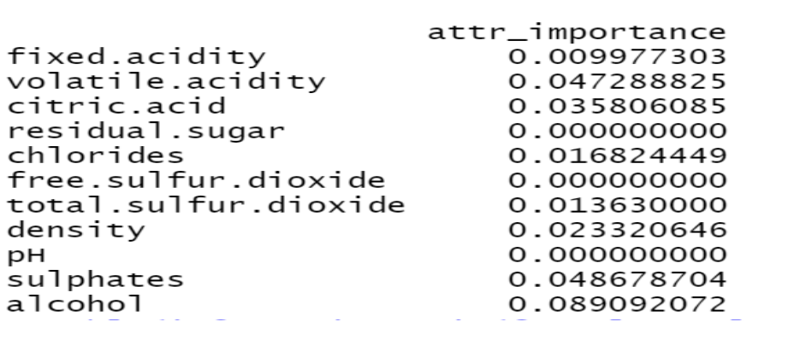

Decision tree

Slide 11
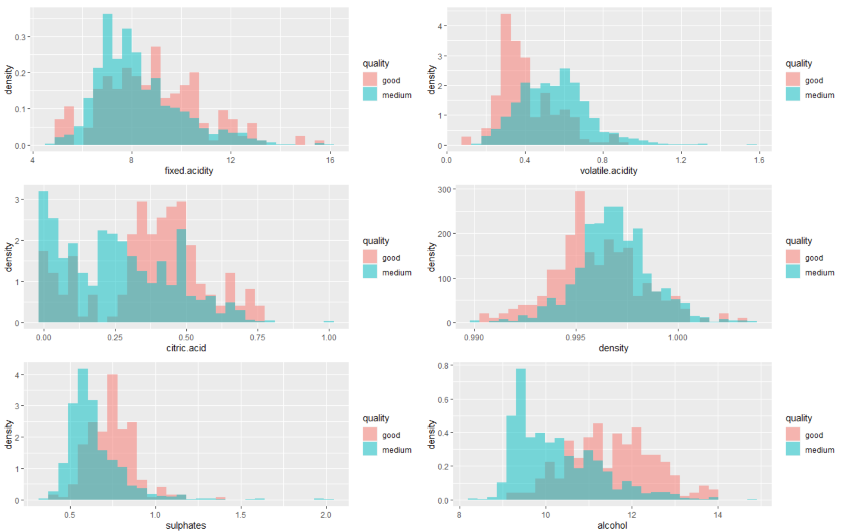
Conclusion
Based on the analysis from different models, we found significant implements as below:
Volatile.acidity good
Sulphates good
Alcohol good
Good predictictive model--Naive Bayes

